Slide 1


Five Year Forecast
Oliu
Model v1.86

Slide 2
Agenda
Review current 5 year forecast for Oliu
Forecast Objective
Model Oliu as a SaaS business
Outline a path of growth objectives for Oliu
Based on growth objectives, calculate resources needed by year to scale the business
Determine high-level cash funding needs for years 1, 2, and 3
Believable, macro-level picture of Oliu’s scale

Slide 3
ATB Forecast Requests – 6/16/22
Revenue by segment slide
Add % by segment and FTE count
Forecast
R&D year 5 boost to 25% of revenue
Added additional heads and non-wage expense
Add FTE count to this slide
Cash slides, add year 1, 2, 3 indicator
Check cash dip in month 10
Checking
Cash balance slide, comment on cash needs at year 1, 2, 3

Slide 4
Five Year Forecast
Revenue driven by three customers segments
Small, medium, and enterprise businesses
Customer churn assumed
Contracted MRR/ARR pricing model
Initial focus on enterprise and medium customers
COGS departments are responsible for revenue delivery
Scales with revenue
Margins should improve over time
OpEx includes large, initial investment in R&D.
Sales and marketing expense should scale with annual bookings targets.

Slide 5
Pricing/Revenue
Initial ICP includes small, medium, and enterprise businesses.
Initial roll out of subscription pricing by Ideal Customer Profile (ICP).
Small $6K/annual
Medium $50K/annual
Enterprise $250K/annual
Pricing can fluctuate as prices above are assumed annual ACV’s.
Revenue forecast includes assumed churn
2.5% monthly for small and 10% annually for medium/enterprise
Usage pricing/revenue is not considered.

Slide 6
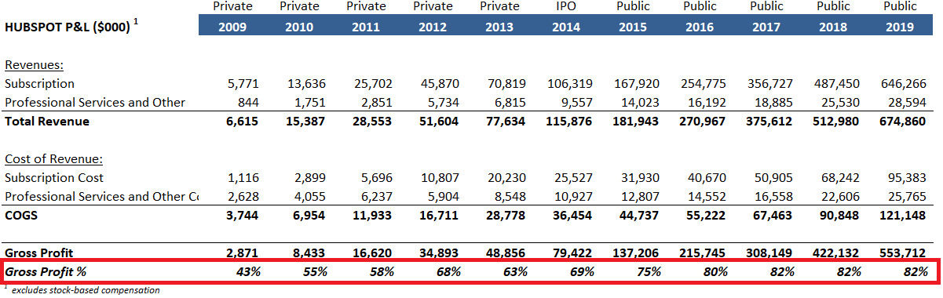
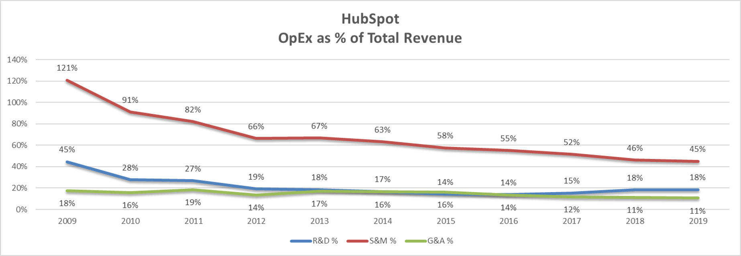
HubSpot Example of Scaling SaaS
HubSpot example demonstrates heavy investment and then efficiency with scale.

Slide 7
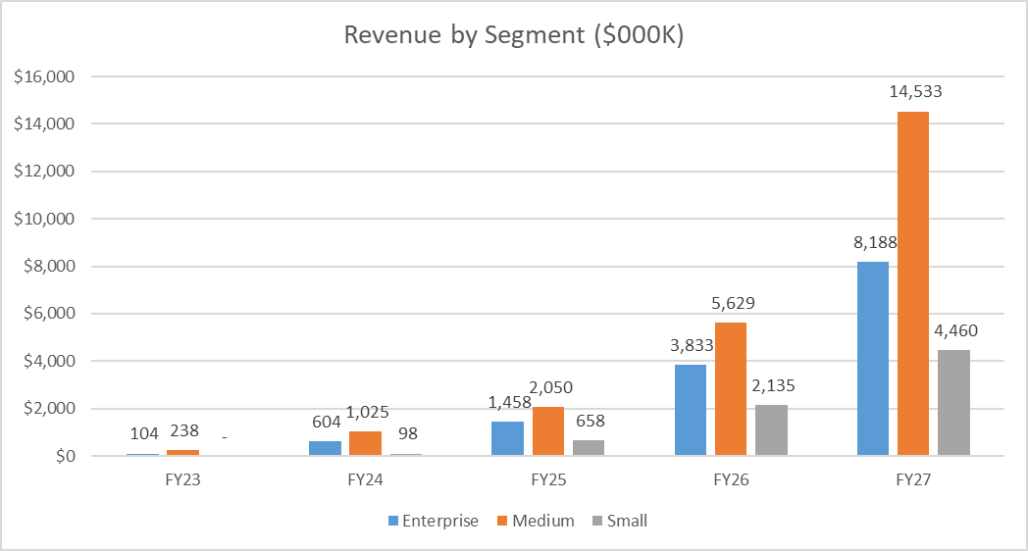
Revenue by Segment
Initial go-to-market focus on enterprise and medium customers. Three ICP’s will require two, distinct go-to-market motions; inbound vs. outbound.

Slide 8
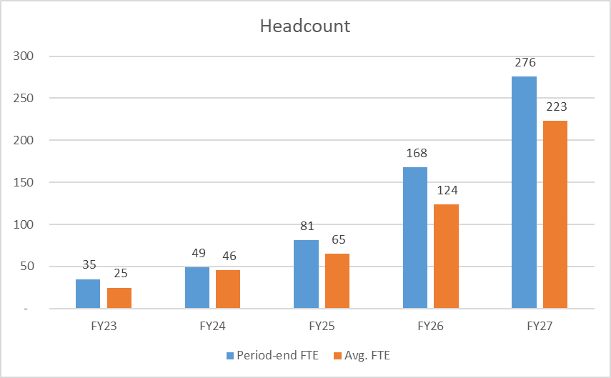
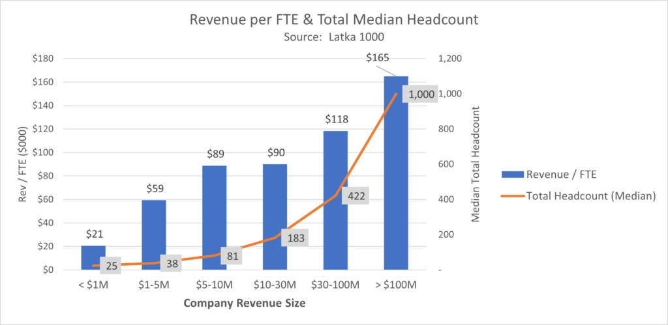
Headcount
Headcount build follows private SaaS benchmarks. Assume inefficient scaling in initial years as growth requires large investment. Common SaaS pattern.
Latka 1000 slides is a reference to private company SaaS benchmarks.

Slide 9
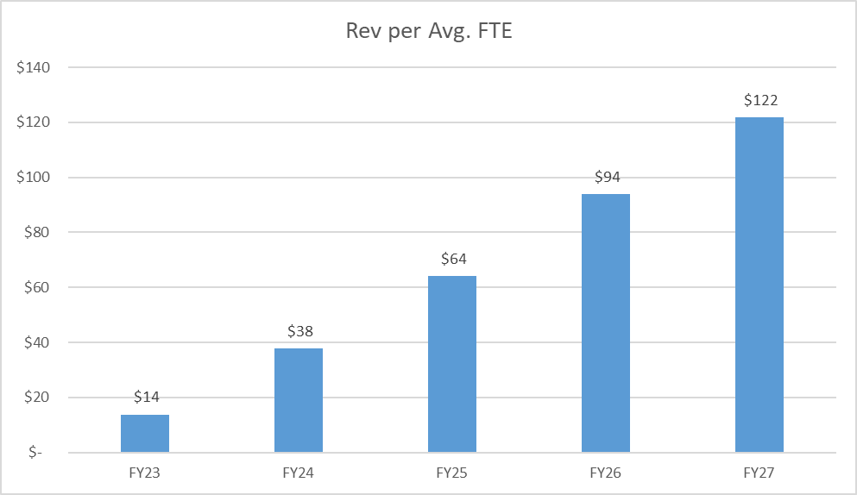
Revenue per FTE
Assumes inefficient org structure as Oliu rapidly scales. Year 5 (FY27) reaches modest FTE efficiency.

Slide 10
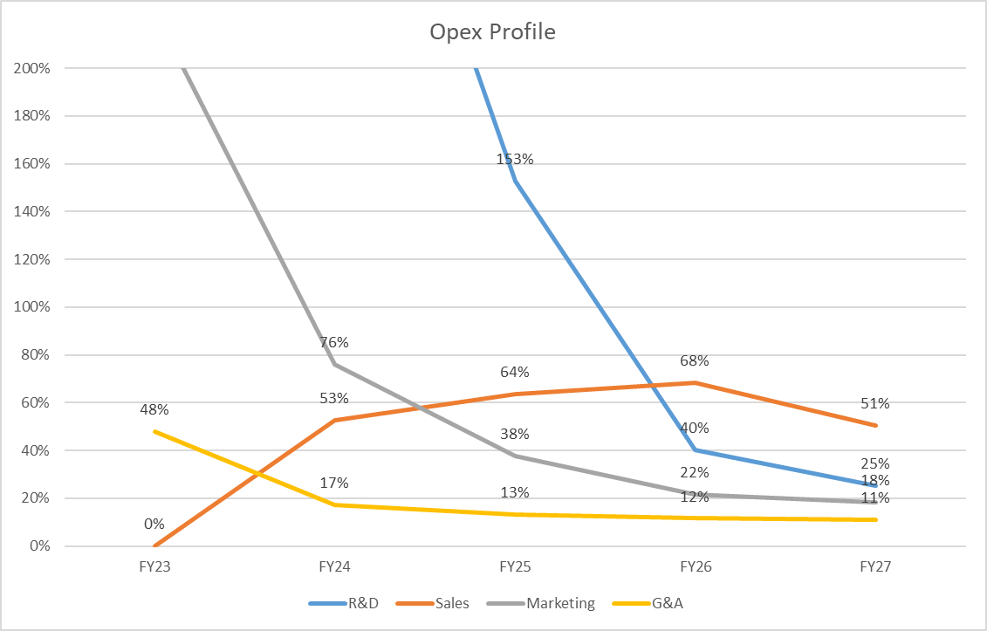
OpEx Profile
Heavy investment in R&D, Sales and Marketing. We monitor as a % of revenue to ensure investment ultimately trends efficiently over time.

Slide 11
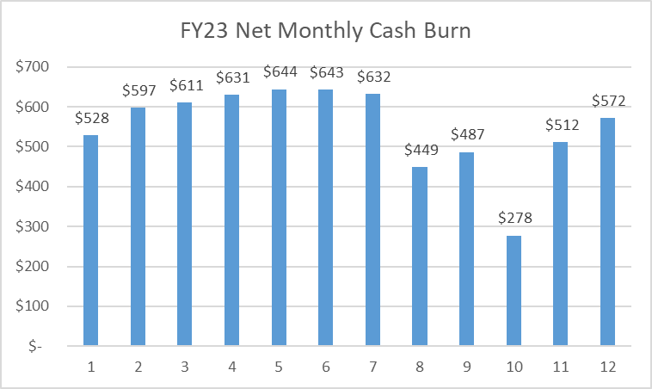
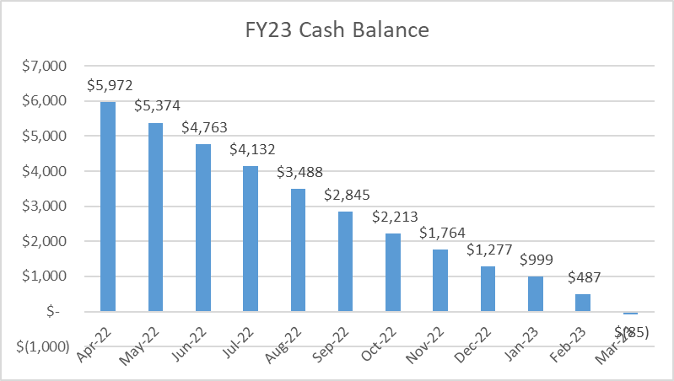
Cash Balance and Net Burn
Month 10 lower cash burn due landing large ACV, enterprise customers who pay upfront, annually.

Slide 12
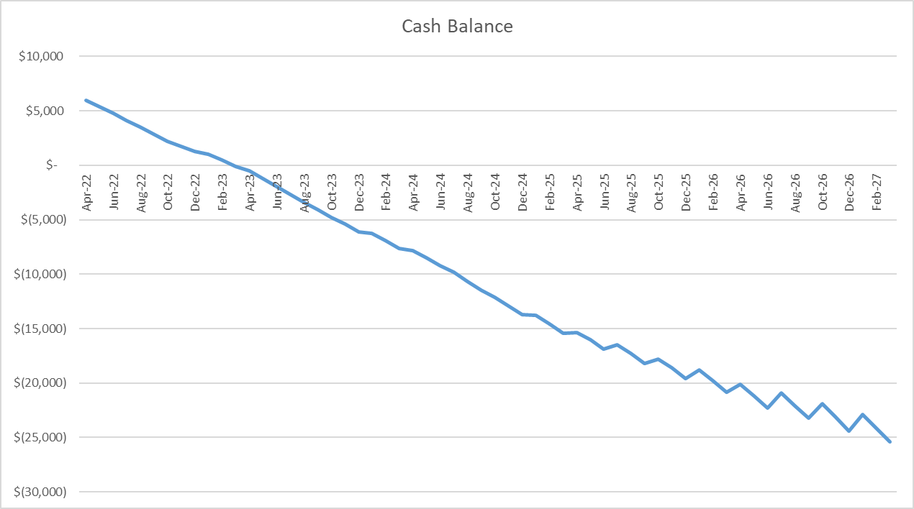
Cash Balance
12 months
Consume $6.5M seed round
24 months
Consume $7.5M
36 months
Consume additional $7.8 for a total cash deficit of $15.3M
Year 1
Year 2
Year 3

Slide 13
ATB Forecast Requests – 6/9/22
Add COGS expense to reduce gross margin below 70%
Add expense to S&M for more realistic efficiency
End R&D contractors at the end of year 3
Year 2 exit ARR pegged at 2.5M
Add chart for revenue by customer segment
Add chart on capital infusion and runway
Add cash balance and burn

